Slide 1
Java Exception
Nguyễn Văn Khiết

Slide 2
Content
Introduction
Java exception handling
try … catch … finally
Define new exception

Slide 3
Exception
An exception is an event, which occurs during the execution of a program, that disrupts the normal flow of the program's instructions.
Example: open a file that is not exist, use an null object, …

Slide 4
Exception handling
When an error occurs within a method, the method creates an object and hands it off to the runtime system
The object, called an exception object, contains information about the error, including its type and the state of the program when the error occurred.
After a method throws an exception, the runtime system attempts to find something to handle it.

Slide 5
Exception handling
The runtime system searches the call stack for a method that contains a block of code that can handle the exception.
The search begins with the method in which the error occurred and proceeds through the call stack in the reverse order in which the methods were called.
If the runtime system couldn’t find an appropriate exception handler through the call stack, the runtime system terminates.

Slide 6
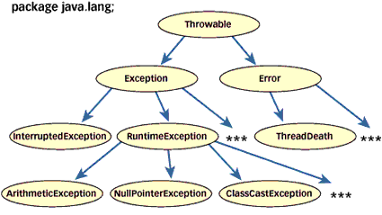
Exception handling
Classes/interfaces related to exception in java

Slide 7
try, catch, finally
try
  {
  //…………..
  }
  catch (IOException ioe)
  {
  //…………..
  }
  catch (NullPointerException npe)
  {
  }
  finally
  {
  //…………..
  }

Slide 8
try, catch, finally
If an exception occurs within the try block, that exception is handled by an exception handler put in a catch block after it
The finally block always executes when the try block exits. This ensures that the finally block is executed even if an unexpected exception occurs

Slide 9
try, catch, finally
class Demo1
{
public static void main(String args[])
{
try {
int a = 5/2;
System.out.println(a);
}
catch( Exception x) {
System.out.println("Exception:"+ ex.toString());
}
finally {
System.out.println("Doing before leaving try..catch...");
}
System.out.println(“Finish !");
}
}

Slide 10
Throw exception
Creating an exception object and handing it to the runtime system is called throwing an exception
Syntax:
throw exceptionobject;

Slide 11
Example
Demo1.java

Slide 12
Define new exception
We can create user-defined exceptions: checked and unchecked exceptions
A checked exception is a type of exception that must be either caught or declared in the method in which it is thrown, (extends from Exception)
An unchecked exception is the one which occurs at the time of execution. Runtime exceptions are ignored at the time of compilation (extends from RuntimeException)

Slide 13
Example
Demo2.java

